Slide 1
Mod 1 Project – King County Housing Data
Thomas O’Gara
Part time data science
Instructor: Victor Geislinger

Slide 2

Problem Statement:
How do we go about predicting home values in King County?

Slide 3
Methodology – “OSEMN”
Obtained housing data on 21,000+ King County homes
Scrubbed the data for missing values, non-numbers, placeholder values
Exploratory data analysis (EDA)
Modeled the data using multiple linear regression
INterpreted the data to determine the most important factors in valuing a home in King County

Slide 4
Most important variables to predict home prices
Square footage of the home
Grade/build quality
Square footage of the lot
Square footage of neighbor’s homes
Location/neighborhood

Slide 5
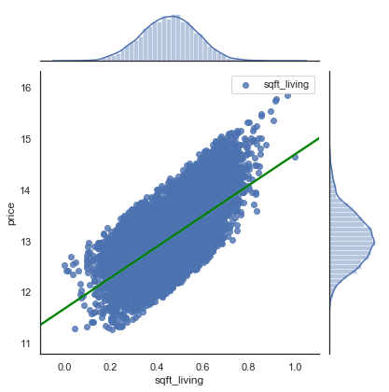
Square footage of the home

Slide 6
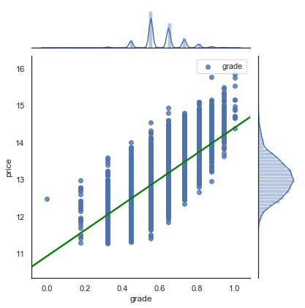
Grade/build quality

Slide 7
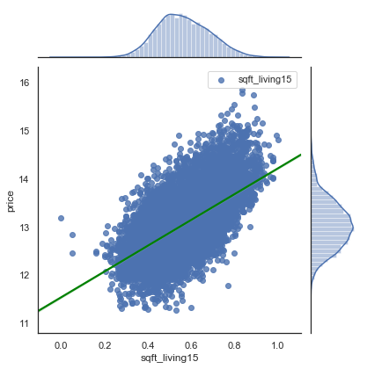
Square footage of neighbor’s homes

Slide 8
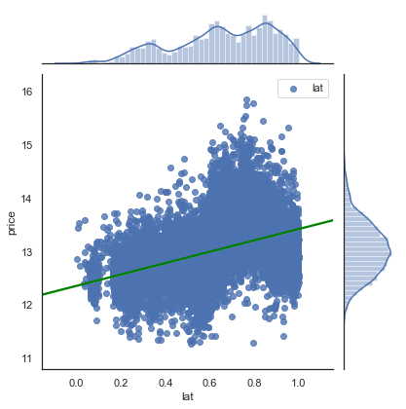
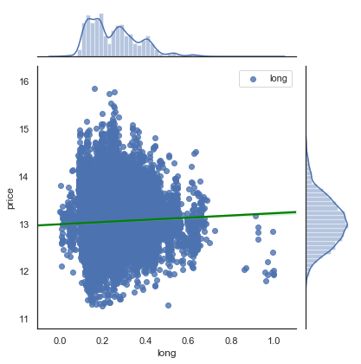
Location - where do you want to be?

Slide 9
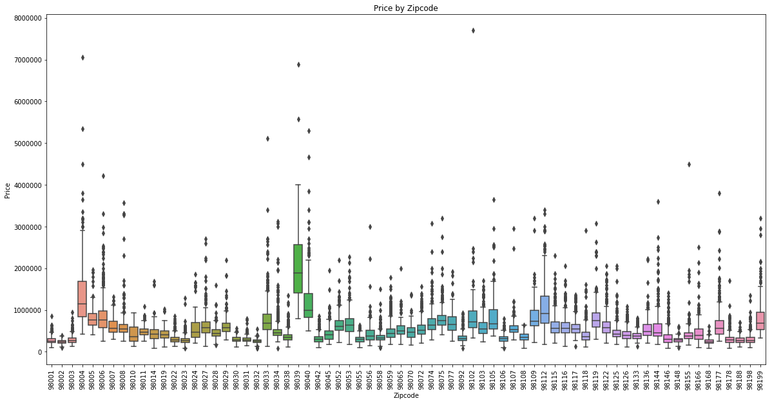

Slide 10
Location continued:
Most expensive zip codes:
98004: Medina
98039: Bellevue
98040: Mercer Island
98112: Northeast Seattle
98199: Northwest Seattle

Slide 11
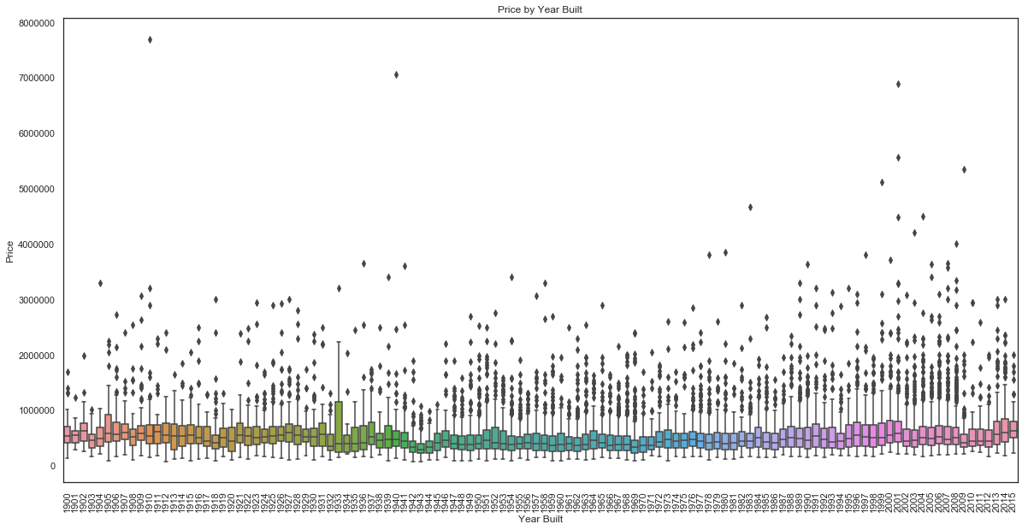
Is a newer home more valuable?

Slide 12
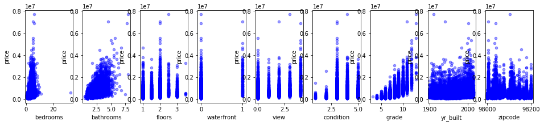
What about other variables?

Slide 13
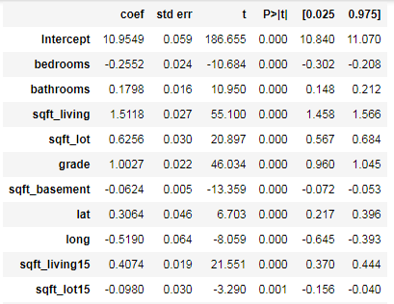
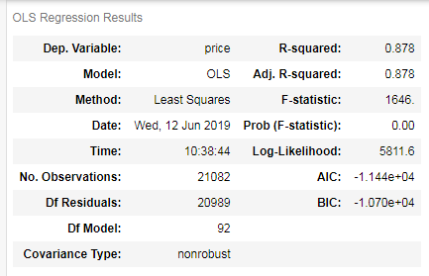
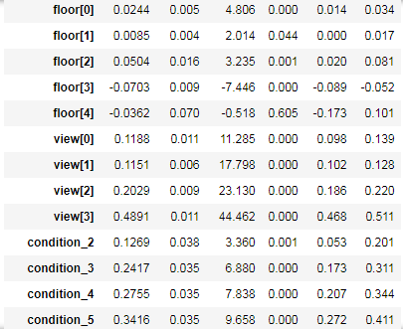
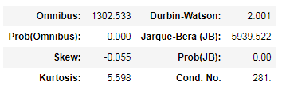
Model Overview

Slide 14
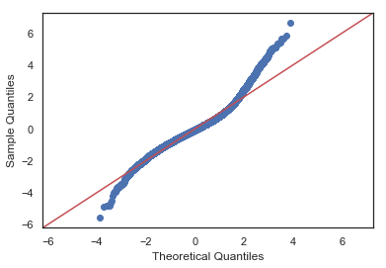
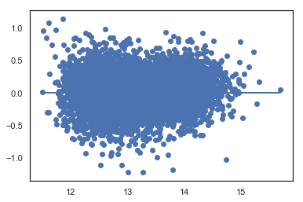
Normality and Homoscedasticity assumptions

Slide 15
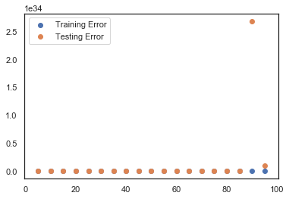
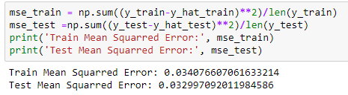
Is this model a good predictor of future home prices?

Slide 16
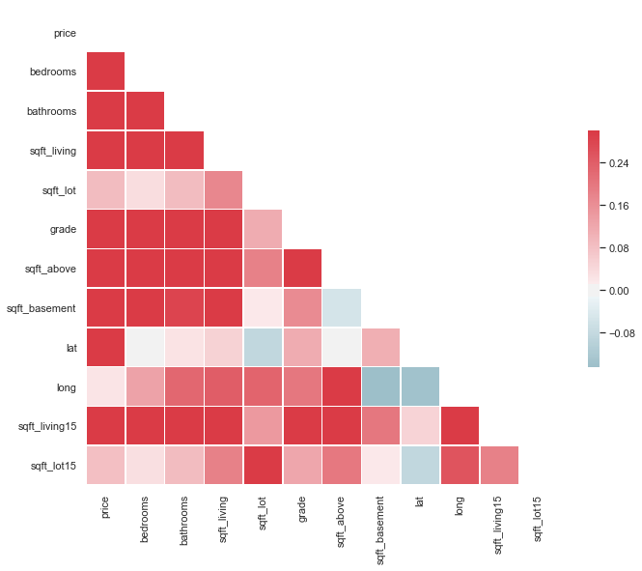
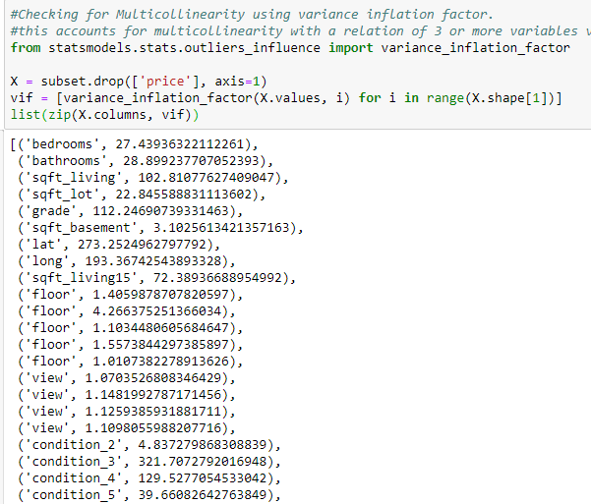
What are potential problems with this model?

Slide 17
Business recommendation for home values
Square footage of living space is key
High grade building
Doesn’t need to be a new build – just needs to be high quality workmanship
Pick a neighborhood with large homes nearby
Better to be the worst house in a good neighborhood
Northwest area of King County is best
Focus on top 5 zip codes
Close to the water

Slide 18
Thank you!
Questions?

